Slide 1
IMPRS workshop
Comparative Genomics
18th-21st of February 2013
Lecture 1
Genetic variation

Slide 2
At what level do we study and compare genetic variation?
Kingdom
Phylum
Class
Order
Family
Genus
Species
Populations
Individuals

Slide 3
What is genetic variation?
Polymorphisms: Variation between individuals in a population (within species)
Substitutions: Fixed variation between individuals of species (between species)
Species A
Species B
Species C

Slide 4
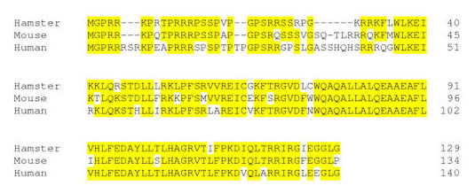
What is genetic variation?
Differences in the nucleotide sequence:
Small scale: mutations in coding or non-coding DNA
Protein alignment Hamster-Mouse-Human

Slide 5
Genetic variation within and between species
Neutral rate of nucleotide substitutions and polymorphisms
- Between species 1 and 2
- Within species 1
- Within species 2
Nucleotide variation in 25kb windows

Slide 6
Differences in the nucleotide sequence at large scale: structural differences across chromosomes
Human and mouse genetic similarities
Mouse chromosomes
Human chromosomes
80 millions years
Notes:
Autosomes

Slide 7
From where does genetic variation come?

Slide 8
From where does genetic variation come?
Mutations
Base substitution mutation rate (10-9 bp/generation

Slide 9
From where does genetic variation come?
Recombination
Shuffling gene variants (alleles) in a population

Slide 10
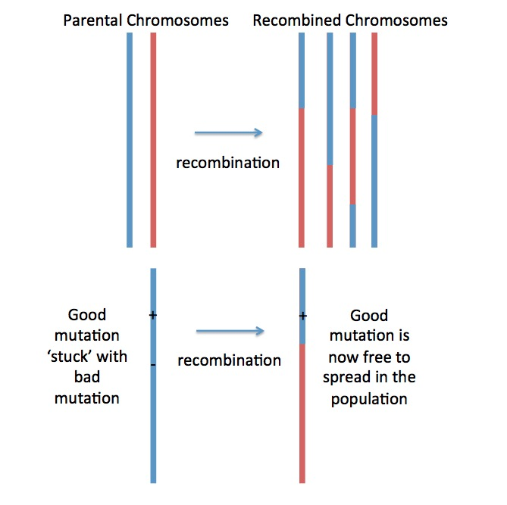
From where does genetic variation come?
Recombination

Slide 11
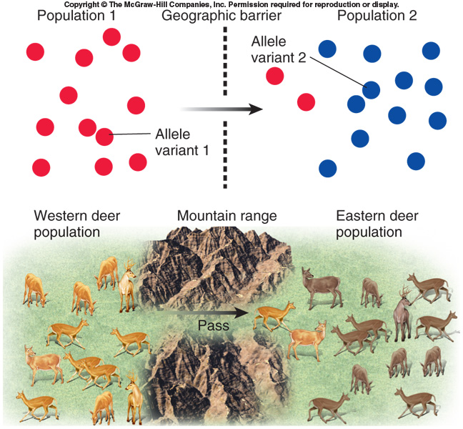
From where does genetic variation come?
Gene flow

Slide 12
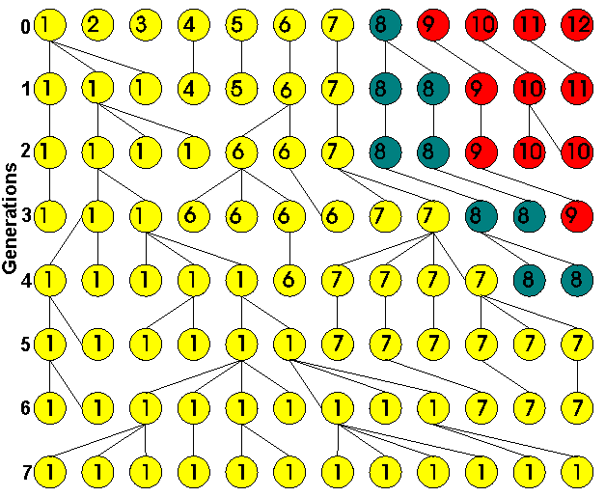
From where does genetic variation come?
Genetic drift

Slide 13
Effective population size
Effective population size: N_{e}
N_{e} is less than the actual number of potentially reproducing individuals!
Sewal-Wrigth (1931)
“The effective population size is the number of breeding individuals in an idealised population that show the same amount of dispersion of allele frequencies under random genetic drift or the same amount of inbreeding as the population under consideration"
Notes:
When a new generation of animals is bred, the offspring gets half of its genes from the mother and the other half from the father. And when the number of fathers and mothers are large the H-W-equilibrium is ensured.
Until now it has been implicit that we are dealing with the same number of individuals of each sex.
In most cases of breeding with domestic animals this is not so. Normally only a few males are used in combination with many females. Thus the effective population size will be smaller than the actual size. The effective population size is based on the number of genes in the population that can be passed on to the next generation. This is assigned the symbol Ne (N-effective) and it has the formula:
Four divided by N-effective equal 1 divided by the number of males plus 1 divided by the number of females.

Slide 14
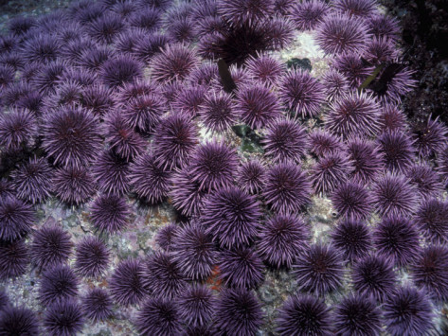
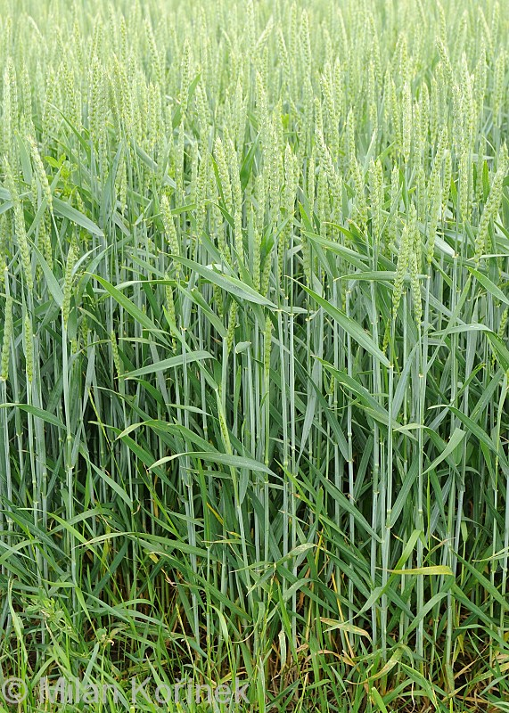
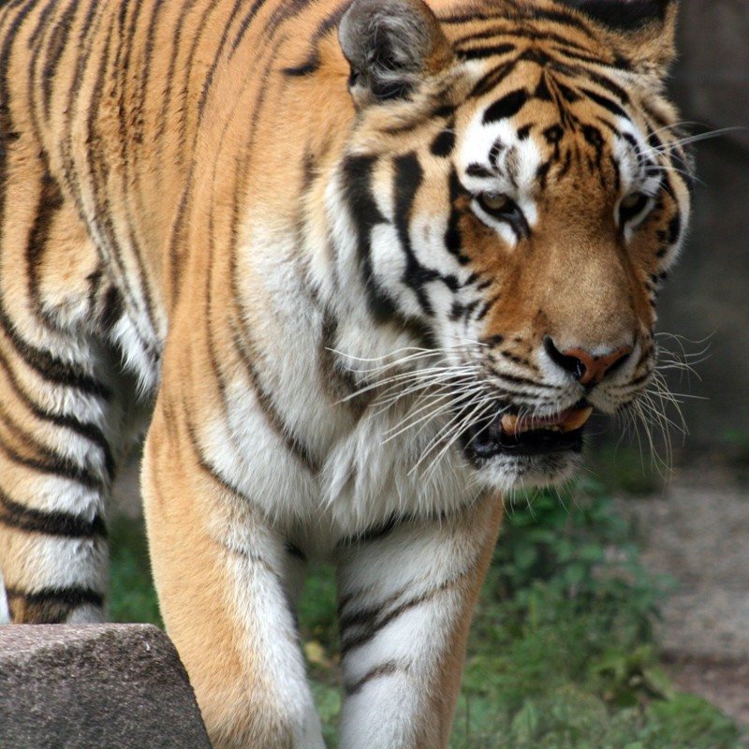
Effective population size
Sea urchins Strongylocentrotus purpuratus
Wheat Triticum aestivum
Tiger Panthera tigris

Slide 15
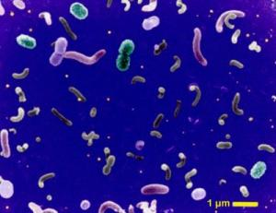
Effective population size
- of Prokaryotes and Archaea?

Slide 16
Why does effective population size matters?

Slide 17
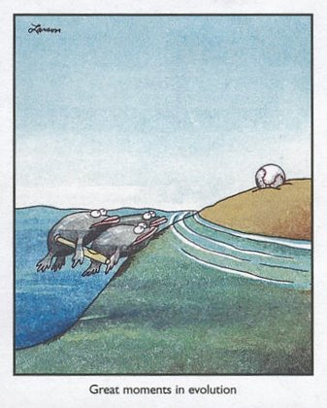
From where does genetic variation come?
Natural selection

Slide 18
Natural selection can act on changes in coding sequences
AGT CTA GGG CTG TGA
ser leu gly leu STOP
AGT CTC GGG CTG TGA
ser leu gly leu STOP
AGT CAA GGG CTG TGA
ser gln gly leu STOP
Non -synonymous mutation
Synonymous mutation
Silent mutation
Replacement mutation
Notes:
Gln glutamine

Slide 19
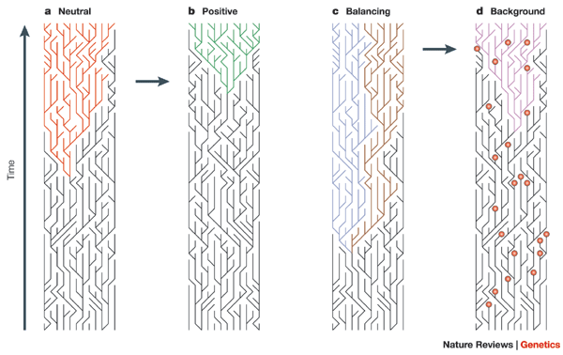
Different types of selection can change the frequencies of
gene variants (alleles)
Natural selection
Bamshad and Wooding, 2003

Slide 20
How can natural selection act on a locus?

Slide 21
Effective population size matters

Slide 22
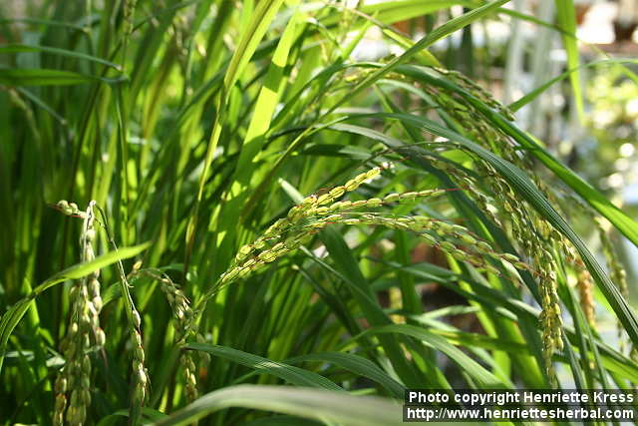

Slide 23
“Domestication cost” in crop species
Mating System | Diversity in Wild(10−3) | Diversity in Cultivated (10−3) | Loci | Lπ (%) | References
 | Zea mays ssp. parviglumis | Zea mays ssp. mays
Outbreeding | πtotal = 9.7 | πtotal = 6.4 | 774 | 35 | Wright et al. (2005)
 | πsilent = 21.1 | πsilent = 13.1 | 12 | 38 | Tenaillon et al. (2004)
 | Medicago sativa ssp. sativa | M. s. ssp. sativa | 2 |  | Muller et al. (2006)
Outbreeding | πtotal = 20.2 | πtotal = 13.5 |  | 31
 | πsilent = 29 | πsilent = 20 |  | 31
 | Helianthus annuus | H. annuus | 9 |  | Liu and Burke (2006)
Outbreeding | πtotal = 12.8 | πtotal = 5.6 |  | 55
 | πsilent = 23.4 | πsilent = 9.6 |  | 59
Mixed | Pennisetum glaucum | P. glaucum | 1 |  | Gaut and Clegg (1993)
 | θsilent = 3.6 | θsilent = 2.4 |  | 33
 | Glycine soja | Glycine max | 102 |  | Hyten et al. (2006)
Inbreeding | πtotal = 2.17 | πtotal = 1.43 |  | 34
 | πsilent = 2.76 | πsilent = 1.77 |  | 36
 | Hordeum spontaneum | Hordeum vulgare
Inbreeding | πsilent = 16.7 | πsilent = 7.1 | 5 | 57 | Caldwell et al. (2006)
 | πtotal = 8.3 | πtotal = 3.1 | 7 | 62 | Kilian et al. (2006)
 | Triticum turgidum ssp. dicoccoides | Triticum turgidum ssp. dicoccum | 21 |  | This study
Inbreeding | πsilent = 3.6 | πsilent = 1.2 |  | 65
 | πtotal = 2.7 | πtotal = 0.8 |  | 70
Loss of variation in domesticated species
Haudry et al, 2007, MBE
Accumulation of non-adaptive mutations in domesticated species
Oi: O. sativa ssp Indica
Oj: O. sativa spp Japonica
Ob: Oryzae brachyantha
Lu et al, 2007, Trends Plant Sci

Slide 24
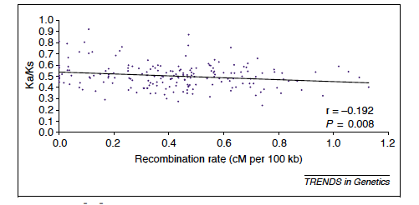
Does a global increase in dN/dS reflects something good or bad?
- and how can be address that?
- Recombination can be used as a proxy for the efficacy of selection

Slide 25
Genetic variation in the genome

Slide 26
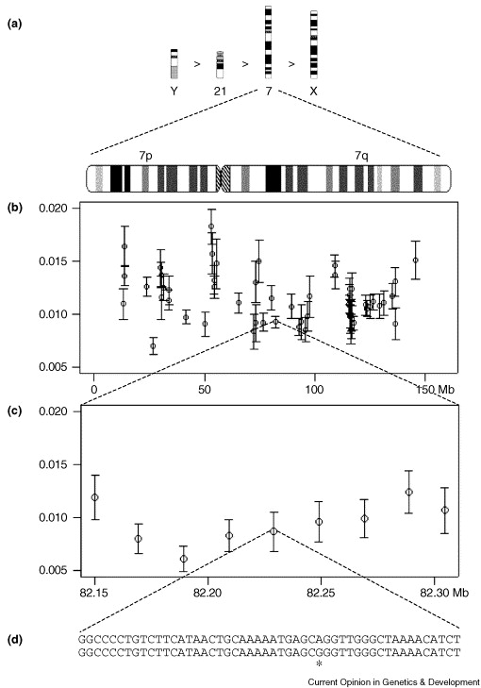
Genetic variation in the genome: Different scales
(a) Between chromosomes
(b) Within chromosomes
Percent divergence
(c) Within regions
(d) Context effects, methylated cytosine mutagenesis at a CpG site
Ellegren et al, 2003

Slide 27
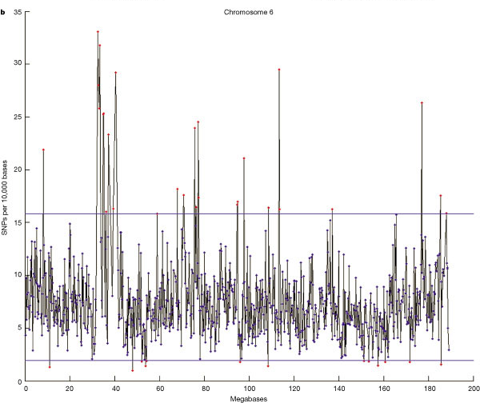
How do we measure and describe genetic variation?
Neutral variation:
Average nucleotide variation within a genome (heterozygosity)
Average nucleotide variation between genomes
Non coding variation
Silent site variation (dS)
Non-silent variation (dN)
Heterozygosity in the human chromosome 6
The International SNP Map Working Group
Nature, 2001

Slide 28
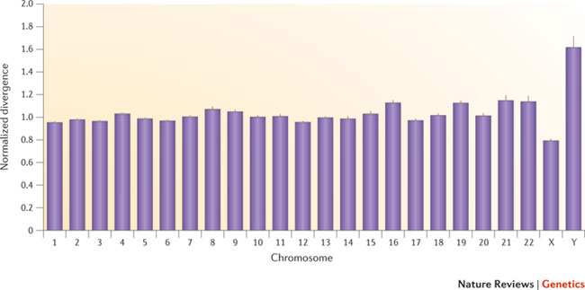
Average divergence between humans and chimpanzees varies across chromosomes
Hodgkinson and Eyre-Walker, 2009, Nature Genetics
Notes:
The average divergence between humans and chimpanzees for each chromosome, normalized such that the average divergence across chromosomes is equal to 1, along with the standard error given by the black line.

Slide 29
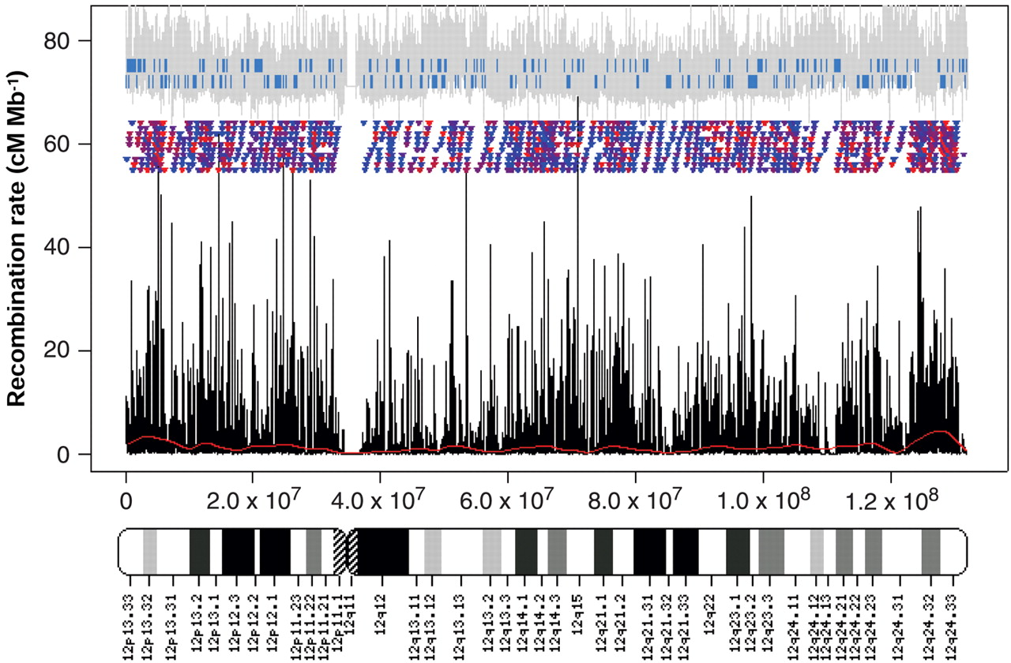
Recombination rate is heterogeneous across chromosomes
GC content
Genes
recombination hot spots
Meyers et al, 2005
Notes:
Fig. 1. Recombination rate variation along chromosome 12. Shown are estimated recombination rate
(black), locations of statistically significant recombination hotspots [triangles; colors indicate relative amount
of recombination from low (blue) to high (red)], and estimated recombination rates from the deCODE
(6) genetic map (red curve near bottom). Also shown are the location of ENSEMBL genes on the two
strands (blue segments), fluctuations in local GC content (gray lines; averages over 1000-bp windows
shown on an arbitrary scale), and an ideogram of chromosome banding.

Slide 30
Assessing signatures of selection across genome sequences
Population data:
Measures of SNPs across a genome alignment
Population data and interspecific comparisons
dN/dS ratios (non-synonymous to synonymous variation)
(Wednesday)

Slide 31
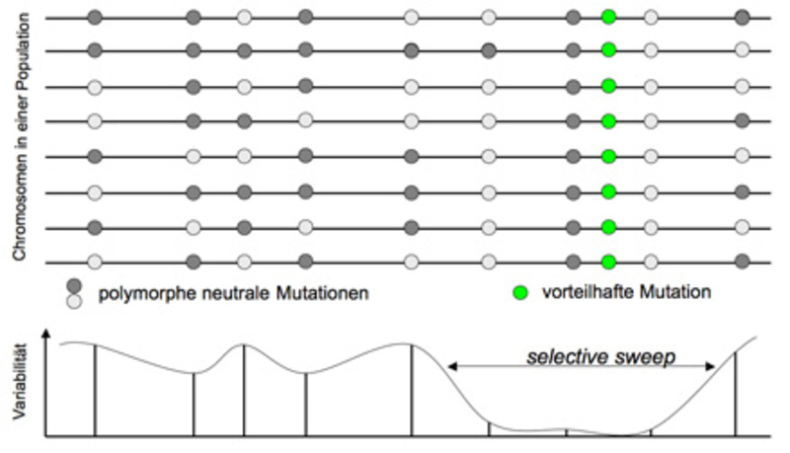
A selective sweep leaves a strong footprint in the genome
Dieter Tautz

Slide 32
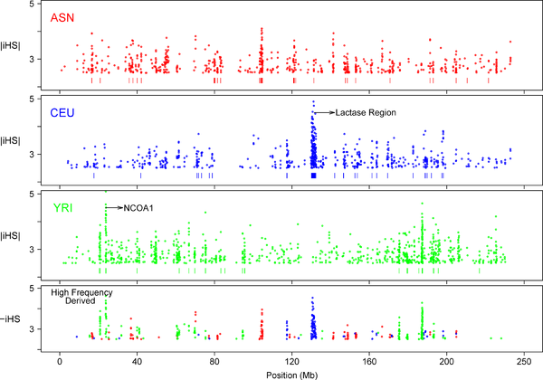
Plots of Chromosome 2 SNPs with Extreme iHS Values Indicate Discrete Clusters of Signals
Asian
iHS is a measure of how unusual the haplotype around a give SNP is
European
African
Voight BF, Kudaravalli S, Wen X, Pritchard JK (2006) A Map of Recent Positive Selection in the Human Genome. PLoS Biol 4(3): e72. doi:10.1371/journal.pbio.0040072
http://www.plosbiology.org/article/info:doi/10.1371/journal.pbio.0040072
Notes:
SNPs with |iHS| >2.5 (top 1%) are plotted. The bottom plot combines signals for all three populations, plotting only SNPs with derived frequency >0.5 and iHS <−2.5. Such SNPs correspond to high-frequency-derived SNPs in the range for which our test is most powerful. The short vertical bars below each plot indicate 100-kb windows whose signals are in the top 1% of windows genome-wide.
how unusual the haplotypes around a given SNP are, relative to the genome as a whole, and it does not provide a formal significance test

Slide 33
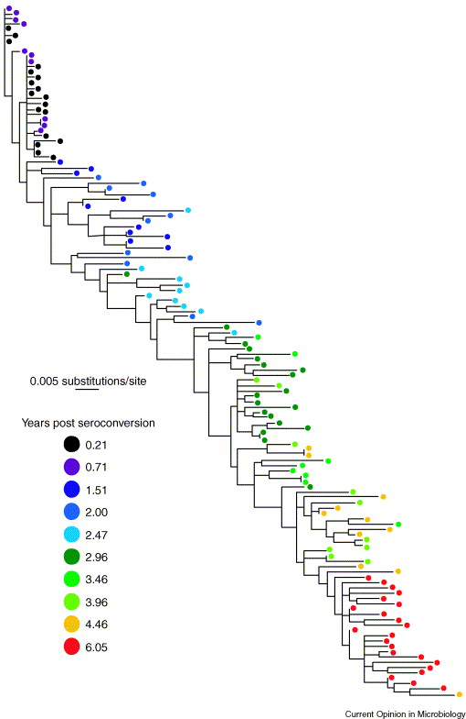
Detecting positive
selection in HIV
New viral variants arise within one patient
The evolution of HIV may be driven by adaptation to the host immune system
Nickle et al, 2003, Curr. Opinion Microbiol.

Slide 34
The HIV genome
LTR-long terminal repeats; repetitive sequence of bases
gag-group specific antigen gene, encodes viral nucleopcapsid proteins: p24, a nucleoid shell protein, MW=24000; several internal proteins, p7, p15, p17 and p55.
pol-polymerase gene; encodes the viral enzyme, protease (p10), reverse transcriptase (p66/55; alpha and beta subunits) and integrase (p32).
env-envelope gene; encodes the viral envelope glyocproteins gp120 (extracellular glycoprotein, MW=120 000) and gp41 (transmembrane glycoprotein, MW=41000).
tat: encodes transactivator protein
rev: encodes a regulator of expression of viral protein
vif: associated with viral infectivity
vpu: encodes viral protein U
vpr: encode viral protein R
nef: encodes a 'so-called' negative regulator protein

Slide 35
Whole Genome Deep Sequencing of HIV-1 Reveals the Impact of Early Minor Variants Upon Immune Recognition During Acute Infection
Evolution of HIV population in patient
- sequencing of viral genome from six time points
Day 3
Day 59
Day 165
Day 476
Day 1543
Day 0
Henn et al, 2012, Plos Pathogens

Slide 36
Rapidly expanding sequence diversity during HIV infection
Heat map showing sites exhibiting amino acid diversity

Slide 37
Genome complexity

Slide 38
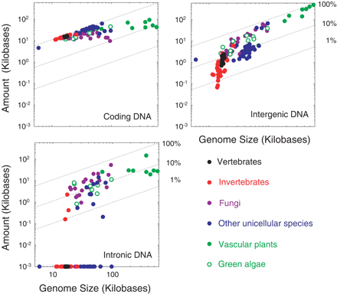
Genome size and complexity
Lynch et al, 2006

Slide 39
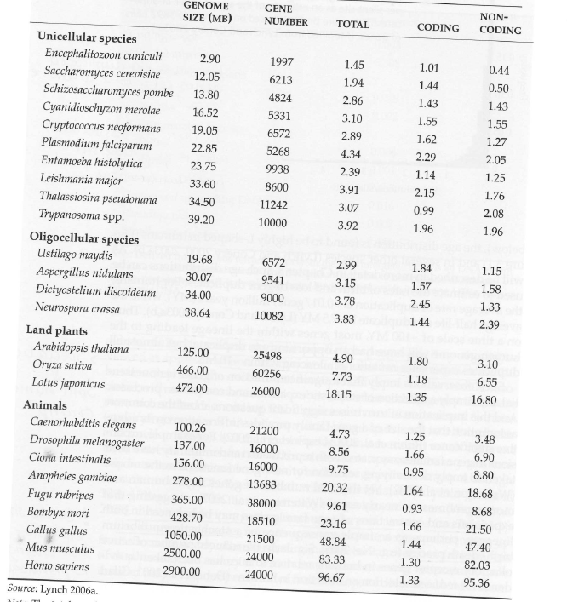
Non-coding DNA matters
Kilobases / gene

Slide 40
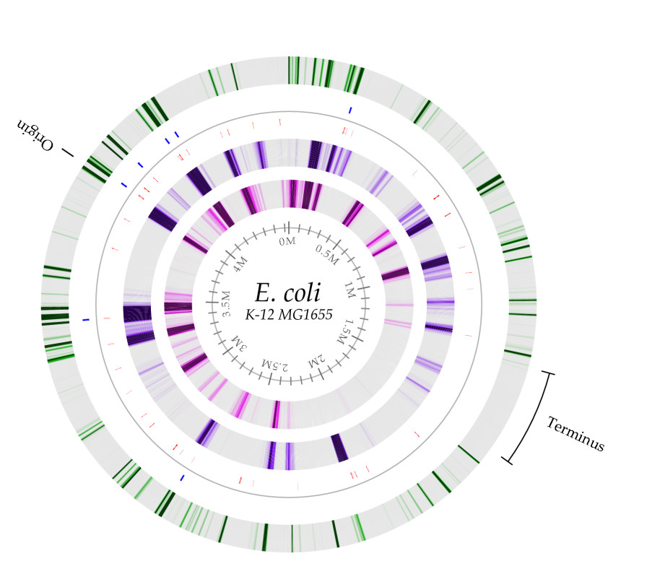
Escherichia coli
Protein-coding genes: 87.8%
Encoding stable RNAs: 0.8%
Non-coding repeats: 0.7%
Regulatory: 11%
Blattner et al, 1997
Monogodin et al, 2005
Archaea genome statistics
Notes:
Protein-coding genes account for 87.8% of the genome, 0.8% encodes stable RNAs, and 0.7% consists of noncoding repeats, leaving ∼11% for regulatory and other functions

Slide 41
Non-coding DNA matters
Intergenic
Average amount of DNA (in kilobases)
 | Exon | Intron | Regulatory | Other
Saccharomyces | 1.44 | 0.02 | 0.11 | 0.37
Aspergillus | 1.57 | 0.27 | 0.03 | 1.55
Plasmodium | 2.29 | 0.25 | 0.04 | 1.76
Caenorhabiditis | 1.25 | 0.64 | 0.43 | 2.41
Drosophila | 1.66 | 2.93 | 1.37 | 2.60
Homo/Mus | 1.32 | 32.27 | 1.95 | 61.14
From Lynch 2007

Slide 42
Synteny

Slide 43
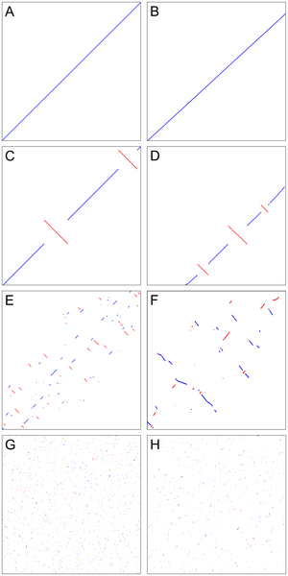
Simulated
data
Observed
data
A+B) Macrosynteny
C+D) Inversions
E+F) Multiple inversions
G+H) Only short syntenic regions
Notes:
A. Two identical sequences show perfect macrosynteny. B. This is also the case for scaffold_1 of Cochliobolus heterostrophus C4 and scaffold_2 of C. heterostrophus C5, reflecting their close relationship as progeny. C. The two sequences from (A) have each undergone one random inversion. D. Scaffold_4 of C. heterostrophus C5 and scaffold_9 of C. sativus show a very similar pattern as in (C). E. The two sequences in (A) have each undergone 25 random inversions. F. Scaffold_8 of Setosphaeria turcica and part of scaffold_10 of C. heterostrophus C5 show a pattern of syntenic regions progressively spreading across the scaffolds similar to that in (E) G. The two sequences from (A) have each undergone 500 random inversions. Syntenic regions are short and spread homogeneously across the two scaffolds. H. Scaffold_1 of Dothistroma septosporum and scaffold_1 of Mycosphaerella populorum show a very similar pattern as in (G). Scaffolds in this figure are not drawn to scale.

Slide 44
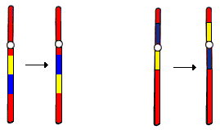
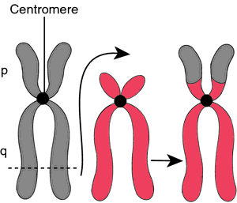
Different recombinational events lead to synteny breakpoints
Inversions
Translocations
Paracentric inversion
Pericentric inversion

Slide 45
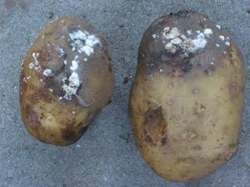
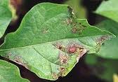
Oomycete plant pathogens
Genome alignment of Phyophthora species
Black boxes=repetitive sequences
BJ Haas et al. Nature (2009)

